Slide 1
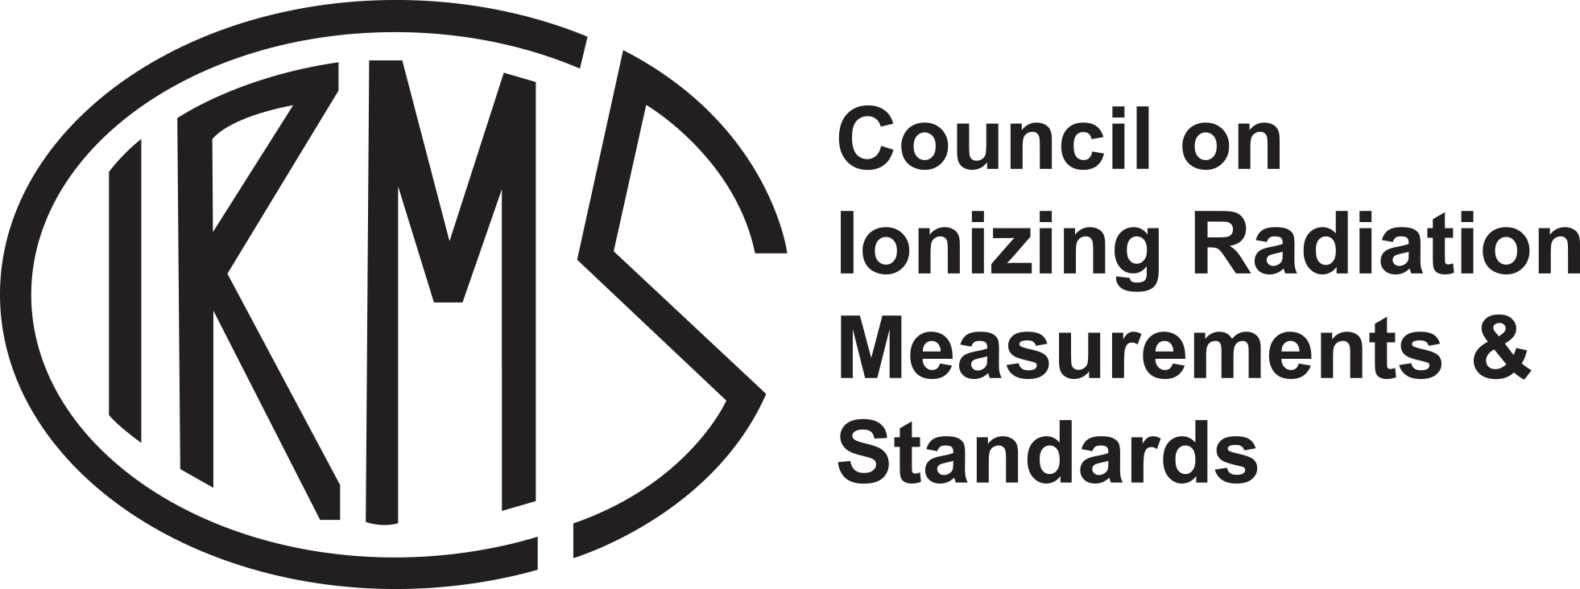
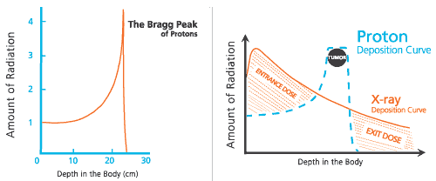
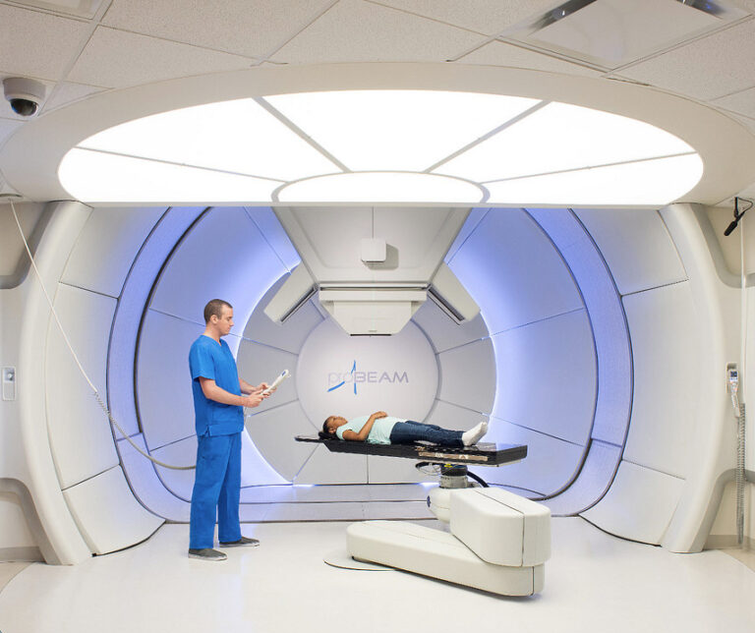
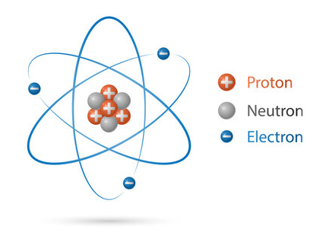
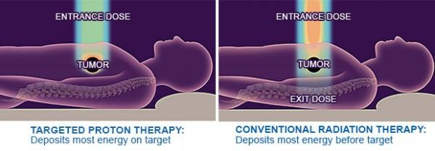
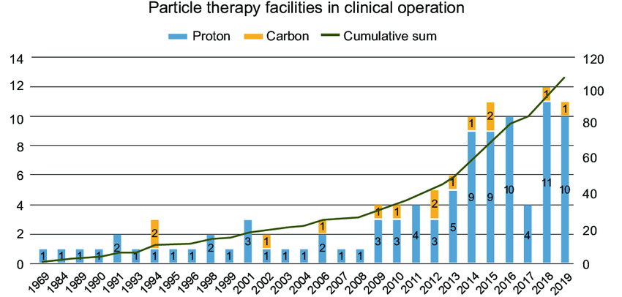
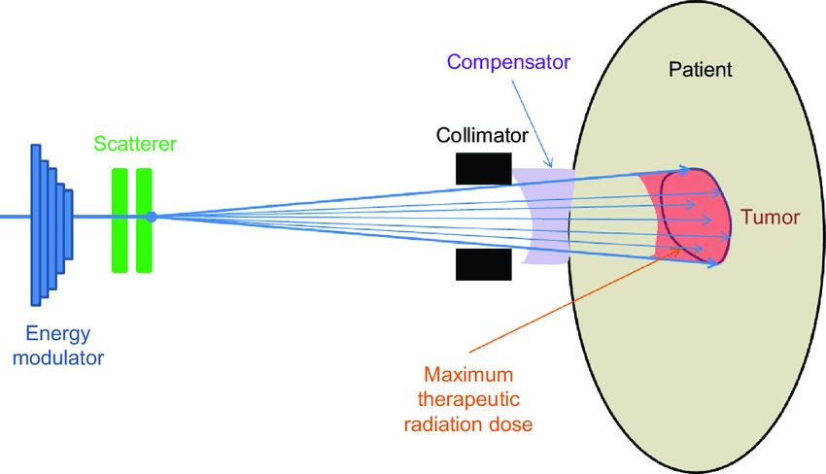
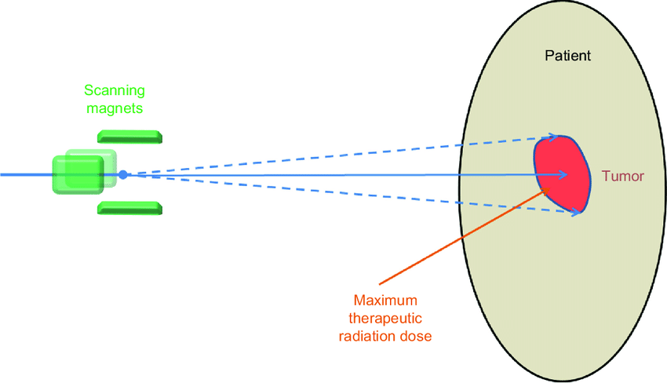
2024 STUDENT Radiation Technology Poster:
Proton Therapy: Advancing Cancer Treatment through Precision
Chris P. Bacon
Universities at Shady Grove, Rockville, MD, chris.p.bacon@umd.edu
BACKGROUND
Proton therapy is a cutting-edge medical technology that has revolutionized the field of cancer treatment. Unlike traditional radiation therapies that use x-rays, proton therapy uses charged particles called protons to precisely target cancer cells. Proton therapy originated from the concept of particle therapy, which dates back to the early 20th century. The idea of using charged particles for cancer treatment gained momentum in the 1940s and 1950s, but it was not until the development of accelerators that proton therapy became a reality. The first clinical treatments using protons took place in the 1950s, marking the beginning of a new era in cancer treatment. These first treatments were performed with particle accelerators built primarily for physics research. The first hospital-based proton therapy center was opened in 1989 at the Clatterbridge Centre for Oncology in the United Kingdom. As of 2024, there are 44 proton therapy centers operating in the United States.
SOCIETAL BENEFITS
The adoption of proton therapy has brought forth numerous societal benefits, contributing to the advancement of cancer treatment and patient outcomes.
Precise control over the dose for treating tumors in sensitive areas, such as the brain, eye, spine, and pediatric cancers
Higher dose to tumor and reduced damage to surrounding healthy tissues
Potential reduction in overall toxicity, improving quality of life after treatment
However, there are still many open questions about the long-term effects of proton therapy, particularly with respect to the effects of secondary neutrons generated during the treatment. On-going epidemiological studies aim to study the long-term health effects of proton therapy compared to conventional x-ray radiotherapy.
TYPE OF RADIATION USED
Proton therapy distinguishes itself from traditional radiation therapies by the use of protons, which are charged particles with a positive electric charge. The key advantage lies in the physical properties of protons, particularly their ability to deposit energy in a highly localized manner. Unlike X-rays, which deliver radiation along the entire path, protons have a unique depth-dose characteristic, allowing them to release most of their energy at a specific depth within the tissues. This property, known as the Bragg peak, enables precise targeting of tumors while minimizing damage to surrounding healthy tissues.
Compared to X-rays, protons exhibit less scatter and have a lower exit dose beyond the target area. This reduced exit dose is advantageous in sparing critical structures located beyond the tumor, further minimizing the risk of side effects and complications associated with radiation therapy.
Passive Scattering Proton Therapy
CONCLUSION
Proton therapy stands as a testament to the continual advancements in medical technology and their profound impact on cancer treatment. The precision afforded by this innovative approach, along with the unique physical properties of protons, has elevated the standard of care for various cancers. As research and technology continue to evolve, proton therapy holds the promise of becoming even more accessible and tailored to individual patient needs. The societal benefits, ranging from improved treatment outcomes to enhanced quality of life for survivors, underscore the significance of proton therapy in the ongoing battle against cancer.
TECHNOLOGY DESCRIPTION
The process of proton therapy involves several technical components. Accelerators are used to generate high-energy protons, and these protons are then directed towards the tumor through a sophisticated system of magnets and beam-shaping devices. Early proton therapy machines used passive scattering technology involved modulated proton beams, a scatterer to spread the beam laterally, and a compensator to adjust the beam's intensity. However, most proton therapy centers nowadays using the pencil beam scanning technology which manipulates a beamlet of protons onto the patient to administer a desired dose deposition pattern. The treatment planning system plays a crucial role in determining the optimal dose, beam angles and proton energy, to ensure that the protons effectively reach the tumor while sparing adjacent normal tissues. Advanced imaging technologies, such as CT and MRI, assist in precisely delineating the tumor's location and shape.
Pencil Beam Scanning Proton Therapy
SELECTED REFERENCES
Han Y. Current status of proton therapy techniques for lung cancer. Radiat Oncol J. 2019;37:232-248.
Wang D. A critical appraisal of the clinical utility of proton therapy in oncology. Med Devices (Auckl). 2015;8:439-46.
Newhauser WD, Zhang R. The physics of proton therapy. Phys Med Biol. 2015;60:R155-209.
Ahmed KA, Demetriou SK, McDonald M, Johnstone PA. Clinical Benefits of Proton Beam Therapy for Tumors of the Skull Base. Cancer Control. 2016;23:213-9.
Berrington de González A et al. The Pediatric Proton and Photon Therapy Comparison Cohort: Study Design for a Multicenter Retrospective Cohort to Investigate Subsequent Cancers After Pediatric Radiation Therapy. Adv Radiat Oncol. 2023 21;8:101273.

